Slide 1

Accenture - Ralph Lauren
GenAI in Receivables Management
Purdue University

Slide 2
Table of contents
01.
02.
03.
AR Ledger
Disputes
Accounts Receivable Agent & Accounts Receivable
Dispute Resolution Agent & Contract Accounting
Risk & Revenue
Behavioral Insights & Agent for Incorrect Credits
Purdue University

Slide 3
01.
AR Ledger
Saandiya, Tolu, Parth
Purdue University

Slide 4
Current State and Agent Overview
SAP Cash Application (FI-AR)
Human-Driven Process
AI-Driven Process
Automatically match incoming payments to open invoices
Read bank statements + remittance data
Uses reinforced learning from accountants' actions
75% reduction in effort analyzing and reconciling open AR items
Autonomous Matching: AI scans bank statements and remittance data to propose invoice matches
Confidence Scoring:
High confidence → Auto-clearing
Medium confidence → AI recommendation
Predictive Risk Awareness: AI highlights which payments or exceptions need urgent attention
L5 Step: Apply incoming payments to open receivables
Payments received (ACH / Wire / Cash / Check)
AR accountants manually need to:
Investigate remittance data
Match payments to invoices
Clear invoices or flag issues
Lot of high-volume repetitive work
Major processing bottleneck
Notes:
https://youtu.be/16fHuTti6hM

Slide 5
Technical Specs and Details
Data Ingestion (Inputs)
System Architecture
Bank Statement Files:
Ingests standard formats (MT940, BAI2, CAMt) mapped directly to S/4HANA Header/Item tables (FEBKO/FEBEP)
Open Receivables:
Retrieves Open Items (BSID/BSEG) in real-time for matching candidates.
Historic Actions:
Leverages historical accountant actions (clearing relations) to learn customer-specific payment behaviors.
Implementation Requirement:
Minimum 10,000 historical cleared items required for initial model training
Hosted Environment:
Logic runs on SAP Business Technology Platform (BTP) Cloud, minimizing load on the ERP core
Predictive Routing:
Classifies every transaction into one of three buckets: Auto-Clear, Proposal, or Exception (Status 30, 40, 50)
Safety Configurations:
Governed by client-defined Confidence Thresholds (e.g., >90%); low-confidence items default to standard exception workflows.
Continuous Learning:
Model retrains on “Proposal” corrections (Human Confirmation), learning from every manual intervention
Notes:
https://youtu.be/16fHuTti6hM

Slide 6
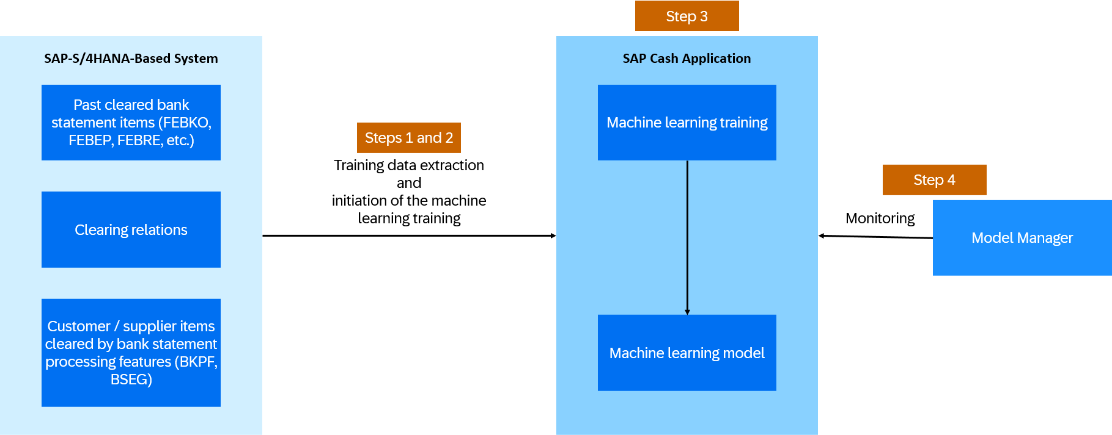
Notes:
https://youtu.be/16fHuTti6hM

Slide 7
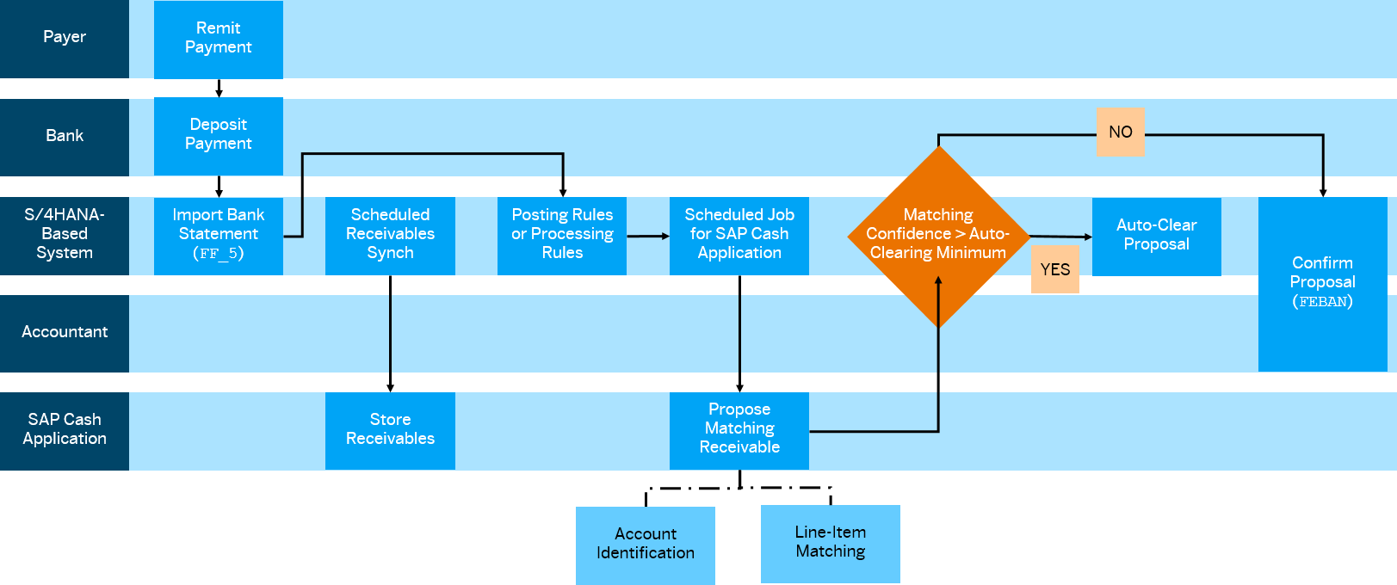
SAP Cash App Automation Logic

Slide 8
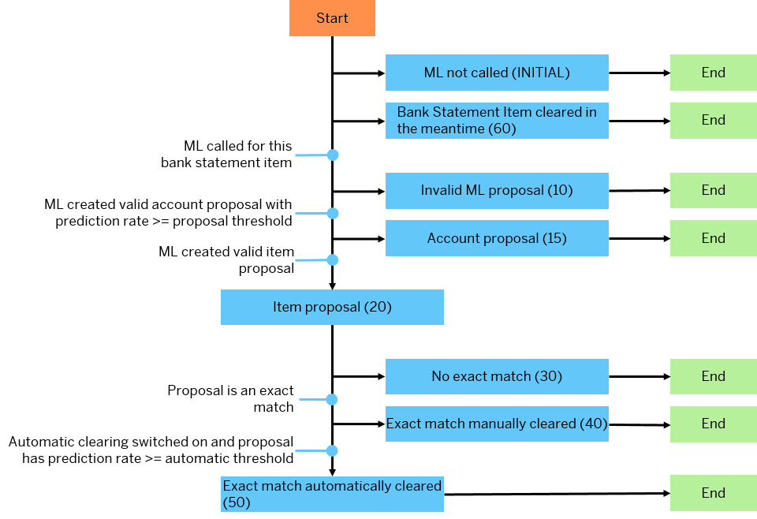

Slide 9
The "Exception" Logic – Handling the Unknown

Slide 10
The "Exception" Logic – Handling the Unknown
Goal: Build trust by explaining how the system handles uncertainty and protects data integrity.
Scenario: The inference job returns an Invalid Proposal (Status 10) or ML Not Called (Initial) because the polling was incomplete or data was insufficient.
Inference Outcome:
Action: No change is applied to the bank statement items. The items remain in the standard processing queue for manual handling.
Automation Level: Manual. The agent identifies that it cannot help and steps aside to prevent errors.
The "Control" Factor: The system is "fail-safe." If the confidence doesn't meet your minimum criteria, it defaults back to your current proven manual processes.
Business Value:
Zero Risk: The AI will never "guess" and mispost a payment.
Continuous Learning: These exceptions are captured for the next Training Data Extraction, making the model smarter for the next run.

Slide 11
The "NO" Logic – Intelligent Suggestions

Slide 12
The "NO" Logic – Intelligent Suggestions
Goal: Show how the agent assists humans even when it can’t fully automate, acting as a "Co-Pilot" for the Accountant.
Scenario: The ML model creates a valid proposal, but the confidence score falls between your Proposal Threshold and Automatic Threshold.
Inference Outcome:
Action: The agent generates an "Confirm Proposal." This is presented to the Accountant in the FEBAN or Reprocess Bank Statement Items app.
Automation Level: Hybrid (Human-in-the-loop). The agent does the "searching," and the human does the "approving."
The "Control" Factor: The human remains the final decision-maker. The agent simply presents the most likely matches, saving the accountant from manual searching.
Business Value:
Reduces "Account Receivable matching effort" by up to 71%.
Ensures accuracy by leveraging human judgment for borderline cases.

Slide 13
The "YES" Logic – High-Confidence Automation
Goal: Demonstrate the "Golden Path" where the agent delivers immediate ROI through hands-free processing.
Scenario: The ML model identifies a valid item or account proposal with a prediction rate that exceeds your defined Automatic Threshold.
Inference Outcome:
Action: The system automatically matches the bank statement item to the open receivable.
Automation Level: 100% Fully Automated. No human intervention is required.
The "Control" Factor: You define the "Automatic Threshold" (e.g., 90%). The agent only pulls the trigger when it is as certain as a human expert.
Business Value:
0.5% reduction in Days Sales Outstanding (DSO).
Eliminates 30-90% of routine manual matching labor.

Slide 14
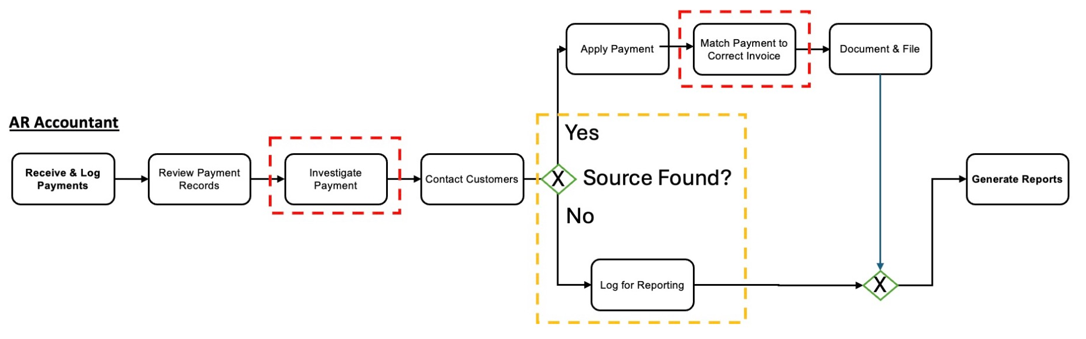
Inference example - ACH/Wire/EFT
Before:

Slide 15
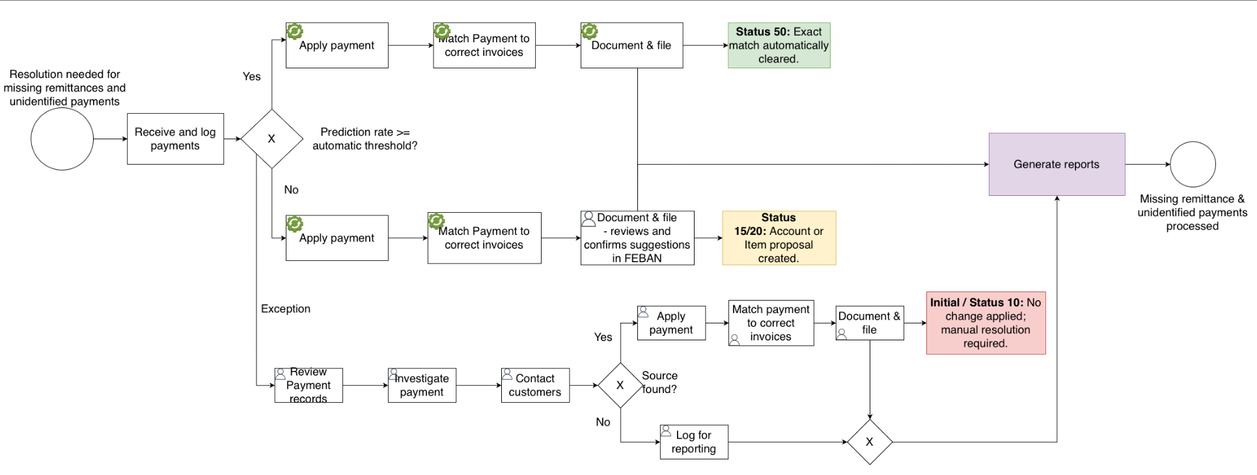
Inference example - ACH/Wire/EFT
After:

Slide 16
Accounts Receivable Agent
To reduce days sales outstanding by 1%.
If an invoice remains open past its due date or a payment cannot be matched.
1. Input Data: The Agent’s 360° View
To provide intelligent recommendations, the AR Agent (powered by Joule) pulls data from across the SAP ecosystem and external sources to understand why a balance is outstanding:
Financial Records: Customer balances, overdue invoices, credits, and detailed aging lists from SAP S/4HANA.
Behavioral Patterns: Historical payment behaviors (e.g., "Does this customer always pay 5 days late?"), collection history, and past dispute resolutions.
Master Data & Risk: Customer creditworthiness profiles and master data identifying key stakeholders.
External Intelligence: Through Joule’s "Deep Research" capability, the agent can tap into external signals, web searches, and even communication logs (emails/CRM notes) to identify if a customer is experiencing broader market stress.

Slide 17
Accounts Receivable Agent
2. Training Logic: How the Model Learns
The AR Agent doesn't just rely on static rules; it uses a multi-layered training and grounding approach to ensure its recommendations are business-accurate:
Historical Pattern Recognition: The model is trained on vast amounts of historical clearing data (ideally 10,000+ items) to identify correlations between customer behavior and collection success.
Domain Grounding in Joule Studio: Unlike generic AI, developers use Joule Studio to "ground" the agent with your specific business documents. For example, uploading your Order Handling Policy or Credit Limit Rules ensures the agent’s advice remains within company guidelines.
Retrieval-Augmented Generation (RAG): When an accountant asks a question about an account, the agent uses RAG to find the most relevant internal documents (like specific contracts or emails) to generate a precise, context-aware answer.
Continuous Feedback Loops: The agent "self-corrects" by observing human decisions. If an accountant repeatedly ignores a specific recommendation, the model adjusts its logic to better align with the human expert’s judgment over time.

Slide 18
Accounts Receivable Agent
3. Outcome: Moving from Analysis to Action
By ingesting these inputs and applying this training, the agent delivers three key outcomes:
Prioritization: It tells the clerk exactly which 10 customers to call first based on the highest risk and highest dollar value.
Recommended Actions: It suggests the specific follow-up (e.g., "This customer responds better to emails than calls").
Ambiguity Handling: It uses Natural Language Processing (NLP) to read "messy" inputs like partial payment notes or inbound customer emails that standard automation would ignore.

Slide 19
Standard Data: Automatic. The agent reads what’s already in SAP.
External Documents: Indexed. Use Joule Studio to "ground" the agent in your specific policy PDFs or email archives.
Live Intelligence: Researched. The agent fetches real-time signals from the web via Joule.

Slide 20
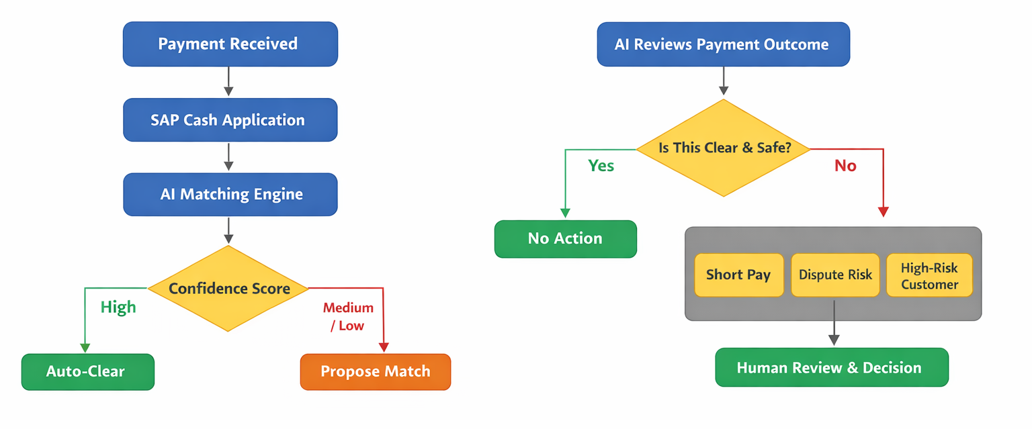
Automation Logic & Decision Thresholds

Slide 21
Accounts Receivable Agent: Enablement for Cash Application (ACH/EFT/Wire)
AI scans bank statements to link unidentified payments to open invoices.
Executes autonomous matching using a >90% confidence threshold for immediate ledger posting in S/4HANA.
Incoming payments matches automatically between 30% and 90%
Utilizes the base Accounts Receivable Agent to reduce uncollectable write-offs through faster clearing.
Automatically flags anomalies and unidentified sources, routing them to the AR Accountant with a generated rationale.
Analyzes historical payment behavior to forecast risks and prioritize the collections worklist.
Enables natural language queries for quick reports and recommendations on complex unidentified payments.
Shifts the AR Accountant role from "Data Entry/Searcher" to "High-Level Reviewer" by automating 90% of investigation effort.
Notes:
Sources, how to increase confidence
What does the “yellow” box is doing, how is it working, why is it beneficial - examples (different scenarios), why the agent rejects/accepts
Before vs after process L5 process
L5 with the agents in them, what will the future L5 look like

Slide 22
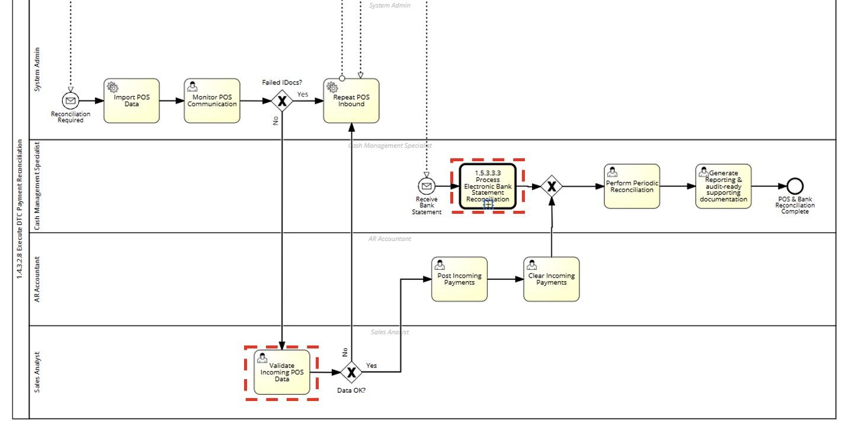
SAP Cash Application: Enablement for DTC & Bank Reconciliation
Leverages SAP Cash Application (Premium) to automate matching between bank statement items and POS records.
Uses machine learning to increase the rate of successful auto-matches, minimizing "manual investigation" for reconciliations.
Automatically records reconciliation accuracy and baseline values to measure program success
Proactively identifies errors in POS data and suggests corrective actions (e.g., repeating POS Inbound).
Shifts the Cash Management Specialist role from searching for discrepancies to remediating errors proposed by AI.
Uses conversational search for navigational assistance in resolving electronic document errors.

Slide 23
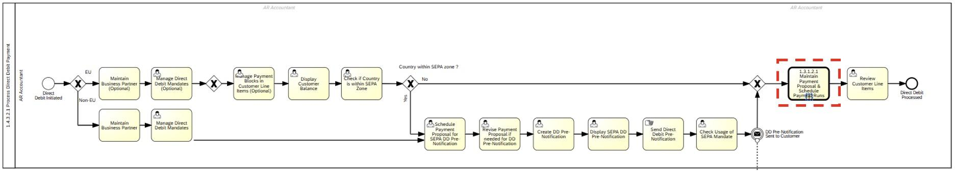
AR Agent: Enablement for Direct Debit
Automatically creates payment proposals based on open item maturity and customer payment terms.
Pre-scans the proposal to identify blocks or SEPA mandate issues before the run.
Self-schedules payment runs based on bank processing windows and liquidity needs.
Shifts the AR Accountant from manually adjusting lines to approving a finalized AI-vetted run

Slide 24
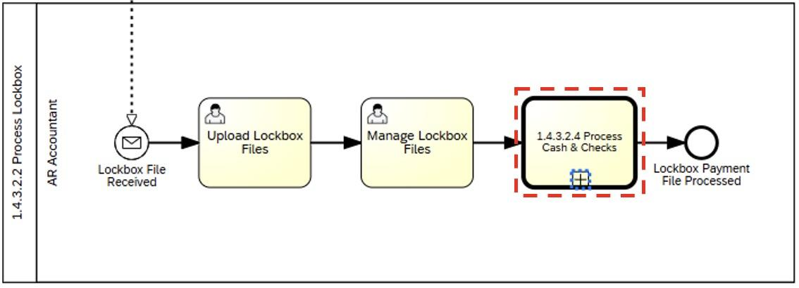
SAP Cash Application: Enablement for Lockbox
Leverages SAP Cash Application (Premium) to clear and recommend matches for high-volume Lockbox files.
Automatically posts matches that meet a high confidence score, bypassing manual entry for standard transactions.
Automatically integrates with external bank files to resolve unapplied cash via behavioral insights.
Proactively identifies uncollectable risks within the clearing process to flag disputes earlier.

Slide 25
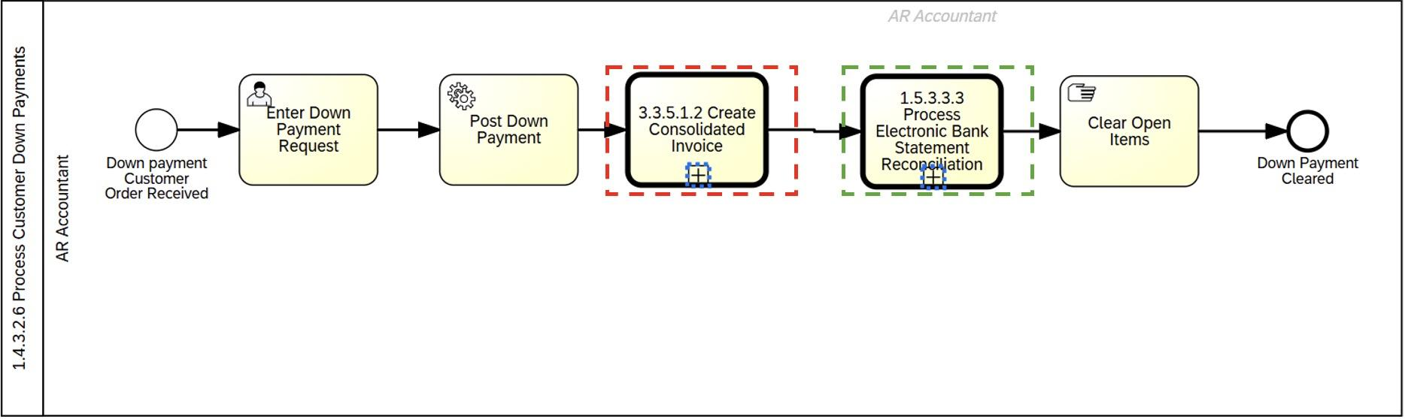
Accounts Receivable Agent: Enablement for Customer Down Payments
AI automatically links down payments to customer orders to generate consolidated invoices without manual intervention.
Proactively validates master data and policy rules to ensure accurate invoice generation.
Compresses the sales lifecycle time by automating the complex link between orders and payments.
Leverages SAP Cash Application to autonomously clear down payments against incoming bank statements.
Forecasts the risk of late or missing payments to prioritize reconciliation tasks for the AR Accountant.
Automatically captures reconciliation baseline values to track project success and ROI.

Slide 26
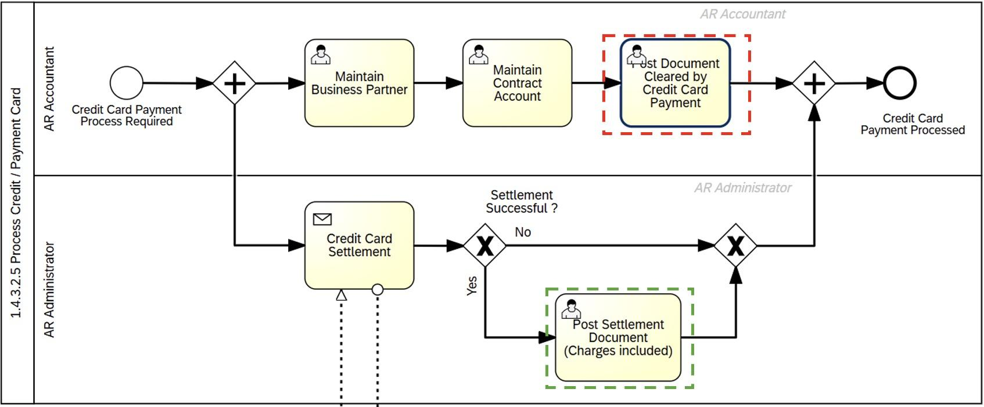
Accounts Receivable Agent: Enablement for Credit / Payment Card
Uses the AR Agent to autonomously match and clear credit card documents against contract accounts.
Automates repetitive administrative clearing tasks, significantly reducing manual effort for the AR Accountant.
Works directly within the business context to ensure real-time ledger updates for cleared items.
Proactively identifies successful vs. failed settlements and suggests the correct posting logic, including fee calculations.
Forecasts settlement failures based on historical bank response codes to prioritize remediation.
Provides a natural language interface for the AR Administrator to investigate settlement errors via the Joule copilot.

Slide 27
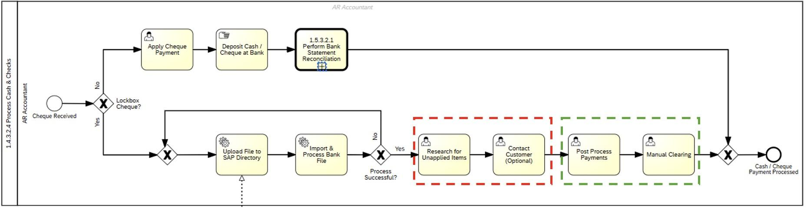
Accounts Receivable Agent: Enablement for Cash & Checks Processing
Replaces "Manual Clearing" by recommending and executing proposed matches for accounts receivable.
Automatically posts matches that fall within tolerance thresholds, bypassing the AR Accountant role.
Proactively identifies uncollectable risks during the clearing process to flag disputes early.
Provides navigational assistance through Joule to resolve any matching errors that require manual review.

Slide 28




The Balanced View: Value vs. Challenges
The Upside (Value)
The Watch-Outs (Risks)
Zero-Touch Velocity
Context Blindness
Instant 24/7 processing drastically reduces Days Sales Outstanding (DSO) by clearing invoices in real-time.
AI struggles to judge intent, often failing to distinguish valid trade discounts from unauthorized short-pays.
Input Sensitivity
Precision
Bad data in = Bad data out. Blurry lockbox scans or messy handwriting can cause automated failures.
Eliminates manual data-entry errors such as typos in invoice numbers or incorrect payment amounts.
'Black Box' Audits
Scalability
It is significantly harder to explain complex AI matching logic to external auditors than standard human notes.
Handles end-of-month volume spikes (e.g., 5,000+ checks) without needing overtime staff
Strategic Implication: The AI handles Volume (Standard Transactions), freeing Humans to handle Value (Exceptions, Disputes, & Relationships)." Video Link

Slide 29
Methodology
Step 1: Define Baseline & Constraints
Inputs: Analyzed the core Accenture/Ralph Lauren engagement brief and standard SAP L5 flowcharts.
Constraint: Designed a conceptual, logic-driven architecture to simulate the transformation, as a live S/4HANA sandbox environment was unavailable for a technical demo.
Step 2: Technical Research
Exploration: Consulted official SAP Help Portals and SAP Cash Application documentation.
Validation: Mapped the exact Machine Learning (ML) inference logic driving autonomous matching.

Slide 30
Methodology
Step 3: Analyze "As-Is" Flows
Deconstruction: Systematically reviewed L5 workflows
Targeting: Identified the manual "Investigate," "Match," and "Research" boxes as the primary drivers of error rates and time
Step 4: Re-Engineer with AR Agent
Overlay: Integrated the Accounts Receivable Agent into the flowcharts to visualize the "To-Be" state.
Logic Rules: Applied confidence thresholds (Yes/No/Exception) to demonstrate the projected 90% effort reduction.

Slide 31
02.
Disputes
Mayank, Byron, Rhea
Purdue University

Slide 32
Current State and Agent Overview
Dispute Resolution Agent
Human-Driven Process
AI-Driven Process
Scan invoices and contracts for errors automatically
Detects incorrect charges and suggest fixes (e.g. creation of credit memos )
30% reduction in Dispute Management handling cost
5% reduction in customer churn attributable to invoice disputes
Automated Case Analysis and Validation:
Determines the validity of cases itself
Key Issues are summarized for human reviewer
Proposes potential resolution options, reviewed by human
Provides a more streamlined dispute process, maintaining stable customer relations
L5 Step: Dispute Case Opening and Management
Manually create dispute cases
Human managers need to communicate with every individual dispute case
Reduces workflow speed
Higher costs for dispute management
Difficulty in tracking and resolving disputes immediately
Notes:
https://youtu.be/16fHuTti6hM

Slide 33
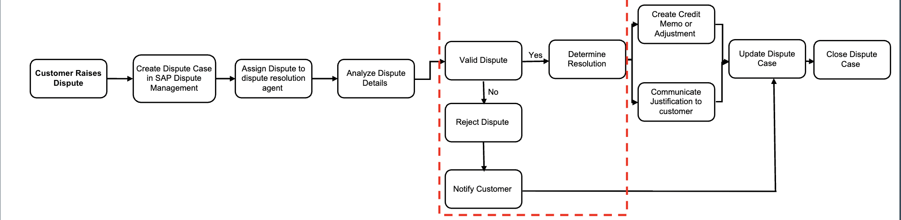
Dispute Resolution Agent
Dispute Case Open & Management Workflow
Automatically reviews invoices and contracts
replaces manual review
Checks if customer complaints are justified
supports faster decisions
Suggests or triggers corrections (e.g., credit memos)
reduces delays and back-and-forth
Notes:
Before State (Manual Process):
Accountants review invoices and contracts
Decide if disputes are valid
Apply orrections
Slow and error-prone

Slide 34
The Balanced View: Value vs. Challenges
The Upside (Value)
The Watch-Outs (Risks)
High-Volume Data Handling
Agent Oversight
Efficient processing of large datasets reduces errors and accelerates dispute resolution.
Agent may not be able to make the most effective decision for more complicated disputes.
Faster Dispute Resolution
Tracking & Resolution Challenges
Real-time tracking of disputes improves accuracy and shortens resolution time.
Difficulty managing multiple disputes at once can delay resolutions and reduce accuracy.
Limited Human Interaction
Stronger Customer Relations
Some customers may prefer to have a more human-involved experience during dispute cases.
More efficient and reduces the “back and forth” between customer and dispute management.

Slide 35
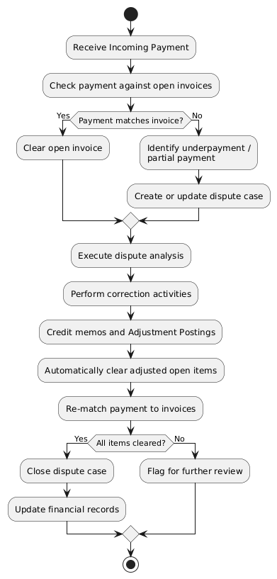
Contract Accounting
Contract Accounting Workflow
—>
Before (Manual Process):
Manually match payments to invoices
Clear accounts after corrections Slow, error-prone, delays dispute closure
Contract Accounting:
Automatically matches payments to open invoices
→ reduces manual work
Detects underpayments or partial payments
→ speeds up dispute resolution
Clears accounts after corrections
→ ensures accurate financials

Slide 36
03.
Risk & Revenue
Allison, Prabhu, Tanvi
Purdue University

Slide 37
Current State and Agent Overview
Behavioral Insights Agent
Human-Driven Process
AI-Driven Process
Predict customer payment risk using behavioral patterns
Identify accounts likely to pay late, default, or require early intervention
Enables proactive collections prioritization and reserve planning
5% reduction in uncollectible AR write-offs
Behavioral Risk Scoring:
Analyzes historical invoice, payment, and customer behavior
Predictive Risk Awareness:
Flags high-risk accounts before missed payments occur
Collections Prioritization:
Recommends account prioritization for outreach and dispute review
L5 Step: Bad Debt Reserves and Allowances
Manual review and validation of valuations assumptions and supporting data
Manual analysis of delinquent accounts to access recovery eligibility
L5 Step: Dispute Management and KPIs
Manual analysis of overdue and unresolved disputes
Review disputes reports and open disputes
Notes:
for the human-driven process you are using human judgement for both.

Slide 38
Overview and Objective: Executive Bad Debt Reserves and Allowances
Context:
Month-end close requires an Allowance for Doubtful Accounts (AFDA) estimate that is timely, defensible, and audit-ready.
Current challenges:
Reserve methodology remains aging-led, with significant analyst overlays and reviewer-to-reviewer variability.
Payment performance and dispute posture are not consistently translated into a repeatable risk segmentation.
Reserve movement explanations are time-consuming due to non-standard driver attribution and evidence capture.
Objective:
Standardize reserve stratification and driver attribution using policy-aligned thresholds, risk segmentation, and exception-based review.
Produce an evidence-backed reserve proposal package that supports leadership review and audit response.

Slide 39
Behavioral Insights Agent: Executive Bad Debt Reserves and Allowances
Purpose:
Improve consistency and speed of reserve estimation by converting broad manual review into risk-segmented, explainable decision support.
What the agent does:
Generates risk scores and risk segments for receivables collectability.
Prioritizes the review population by materiality and risk, with explainability for each recommendation.
Key inputs:
Exposure and aging, payment behavior history, dispute and deduction posture, policy thresholds, and decision history.
Outputs:
Risk-segmented reserve view (Low, Medium, High).
Reserve proposal package with key drivers versus prior close.
Ranked exception worklist requiring review.
Placement in the L5 workflow:
Embedded during month-end reserve review, prior to approval and posting activities.

Slide 40
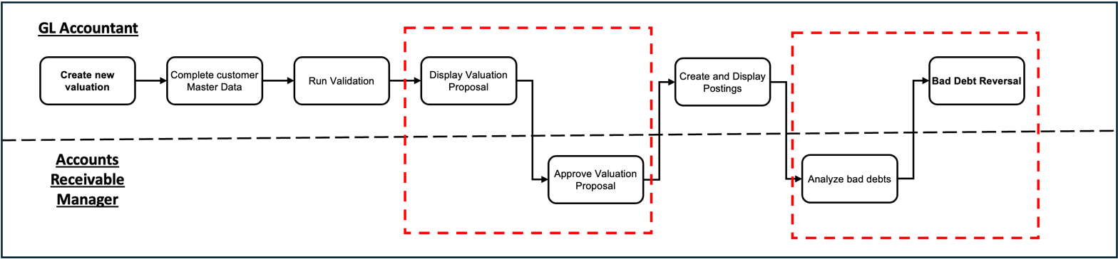
Enablement for Bad Debt Reserves and Allowances
Behavioral Insights Agent: Enablement for Bad Debt Reserves and Allowances
Proposal automation:
Auto-builds valuation proposal package
Pre-checks master data and policy rules, flags issues
Recommends approve or revise with rationale
Auto-approve within tolerance thresholds
Decision support:
Analyzes drivers (aging, disputes, payment behavior)
Flags anomalies and identifies reversals with rationale
Recommends next actions and builds a worklist
Adds explainability for each recommendation

Slide 41
L5 Bad Debt Reserves and Allowances: Significance of Red Box
What the Red Box represents:
A controlled approval node where reserve recommendations become governed accounting outcomes, with segregation of duties and audit traceability.
Why it is retained:
Reserve movements can be financially material and require explicit decision ownership.
Enforces policy adherence through tolerance thresholds and escalation rules.
Ensures audit defensibility through documented rationale and evidence references.
Enables judgment-based review for edge cases that scoring cannot fully contextualize.
What routes into the Red Box (exceptions):
Reserve movement outside tolerance (absolute or percent).
Exposure above materiality threshold.
Data readiness or policy eligibility failures (missing master data, cut-off issues, rule conflicts).
Anomaly conditions (reversals, abrupt bucket migration, conflicting indicators).
Any override request.
What the Red Box produces:
Approve, adjust, defer, or escalate decision.
Mandatory rationale and evidence references logged.
Audit-ready decision trail (who, what, why, when, based on which inputs).

Slide 42
Future-state L5 flow: Without vs With agent
Without agent (current state): | With agent (future state):
Population-wide review of aging and exposure, followed by manual overlays and segmentation. Manual driver attribution and reserve movement narrative built late in the close cycle. Iterative reviews due to inconsistent evidence packaging and reviewer variability. Audit support often requires follow-up work to reconstruct decision basis. | Upstream automation generates segmentation, reserve proposal, driver attribution versus prior close, and anomaly flags. Routing separates standard items from exceptions based on tolerance and materiality thresholds. Exceptions route to the Red Box for approval, overrides, and documented rationale. Evidence and decision logs are produced as standard workflow outputs, improving close readiness and audit response.
Net shift:
Move from full-population manual review to threshold-driven exception governance, while preserving approvals and audit defensibility

Slide 43
Executive Bad Debt Reserves and Allowances - Data prerequisites and model governance
Minimum data prerequisites
AR open items and aging at close cut-off, with consistent bucket logic.
Customer exposure and clean identifiers linking customer, invoice, payment, and dispute records.
Payment history lookback sufficient to detect deterioration and pattern breaks.
Dispute and deduction posture with consistent status and amount-at-risk fields.
Policy parameters maintained and owned (materiality thresholds, tolerance bands, approval routing).
Model learning and operational governance
Learns collectability risk from historical outcomes (delinquency progression, dispute persistence, write-off and recovery behavior).
Calibrates scores into stable risk bands to support consistent reserve stratification.
Monitors drift via score stability, exception rate, and override concentration, with defined recalibration triggers.
Versions recommendations and ties each output to an input snapshot to support audit traceability and change control.

Slide 44
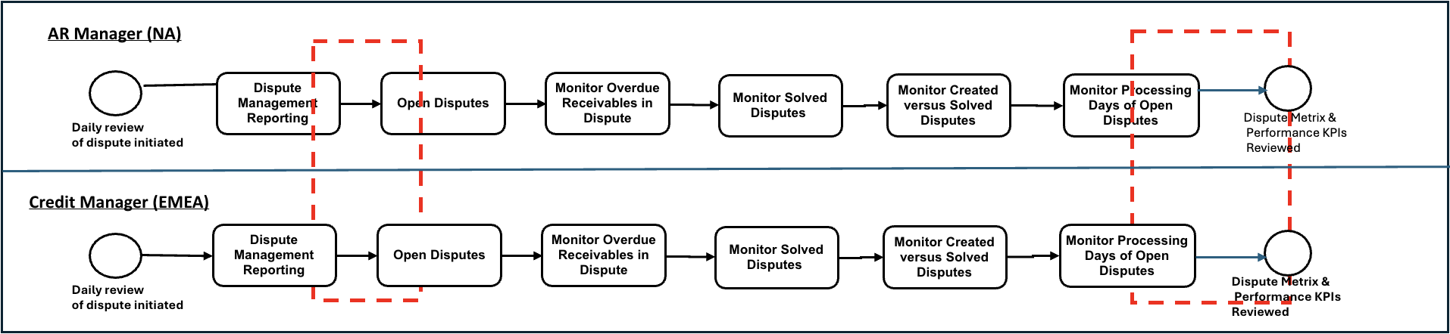
Behavioral Insights Agent: Review Dispute Management Performance and KPIs
add w
Ingests dispute reporting data
Explains key risk drivers (age, amount, etc)
Segments open disputes by risk level
Recommends risk-based prioritization for downstream monitoring and action
Evaluates processing delays in the context of risk
Flags high-risk disputes with extended cycle times
Quantifies potential cash and write-off impact
Provides KPI reviews with risk-weighted insights and explanations

Slide 45
Behavioral Insights Agent: Review Dispute Management Performance and KPIs
Purpose Bring early risk intelligence into dispute performance monitoring so leaders can reduce dispute backlog, shorten cycle times, and prevent disputes from turning into delinquency or write-offs.
How the Agent Works
It continuously reviews dispute, customer, and KPI information.
It looks for warning signs, unusual delays, or patterns that indicate risk.
Each dispute is evaluated for how likely it is to impact cash collection.
The agent then brings the highest-risk items to the top of the queue.
It clearly explains why something needs attention.
When needed, it prompts actions, alerts the right people, and supports management decisions.
Over time, it learns from actual outcomes to make smarter predictions.
Process change (Before vs After):
Before:
KPI reviews look mainly at overall numbers like backlog, aging
Performance is reviewed after issues have already happened, with little early warning
Causes of issues are identified manually, based on judgment and past experience
Root causes inferred manually, often based on experience or intuition
After:
Faster escalation of high-risk disputes
Clearer rationale for prioritization using explainability
Better linkage between dispute handling and downstream cash outcomes

Slide 46
Behavioral Insights Agent: Review Dispute Management Performance and KPIs
Inputs & Requirements for the Behavioral Insights Agent
Dispute details (customer, invoice, reason, owner)
Financial exposure (amount, balance, credit risk)
Aging & cycle time (days open, touches, reopens)
Activity signals (status moves, escalations, promises)
Historical results (paid, overdue, write-off)
Customer behavior patterns
Decision Logic
Predicts likelihood of payment delay or write-off
Uses drivers such as age, amount, customer risk, dispute history, and inactivity
Prioritizes by cash impact × risk, not just age
Detects SLA threats, stagnation, and bottlenecks
Triggers the right escalation and owner
Translates KPIs into forward-looking financial exposure
Business Logic
The Behavioral Insights Agent helps the organization recover cash faster by directing attention to the disputes that matter most. By identifying high-risk items early, it reduces overdue balances and potential write-offs while improving team productivity through smarter prioritization. Managers gain forward-looking visibility rather than relying only on historical reports, enabling quicker and more effective escalations. Over time, this creates a consistent, data-driven way of working across teams and regions, with clearer accountability for both risk and results.

Slide 47
The Balanced View: Value vs. Challenges
The Upside (Value)
The Watch-Outs (Risks)
Predictive Risk Identification
Not Fully Automated
Predicts payment risk early, allowing intervention before balances become uncollectible.
Requires human judgement and action. AI supports decisions but does not execute them.
Data Quality Dependency
Focused Collection Effort
Effectiveness depends on clean and complete historical payment data.
Directs analysts and collections time to the highest risk, highest impact accounts.
Adoption and Trust Risk
Improved Financial Planning
Benefits rely on user adoption and confidence in AI outputs.
Supports more accurate reserve estimates and stable cash-flow forecasting.

Slide 48
Summary of decrease in steps with agent (all process)
Initially, we have X steps
Have 3 different tables (one for each agent and subsequently, for each L5 process)
Whole team to work on this
We can also highlight the advantages like quality, effort and the better results/outcomes.
Need to work
Monday - 11am
Tuesday - 3pm
For scaling up the agent:
Document chronological order of steps – then suggest
For example, Question to solve – Why we don’t recommend AI for a particular step (Try to have similar questions) – whether we can apply a solution
Need to meet each of the teams and the split the steps/process to understand about the scaling up and the overlap of a common pattern
Professor - Ask the team about the
Notes:
for the human-driven process you are using human judgement for both.

Slide 49
Q&A

Slide 50
Incorrect Credits Agent

Slide 51
Executive Bad Debt Reserves and Allowances

Slide 52
Review Dispute Management Performance and KPIs

Slide 53
Revenue Assurance

Slide 54
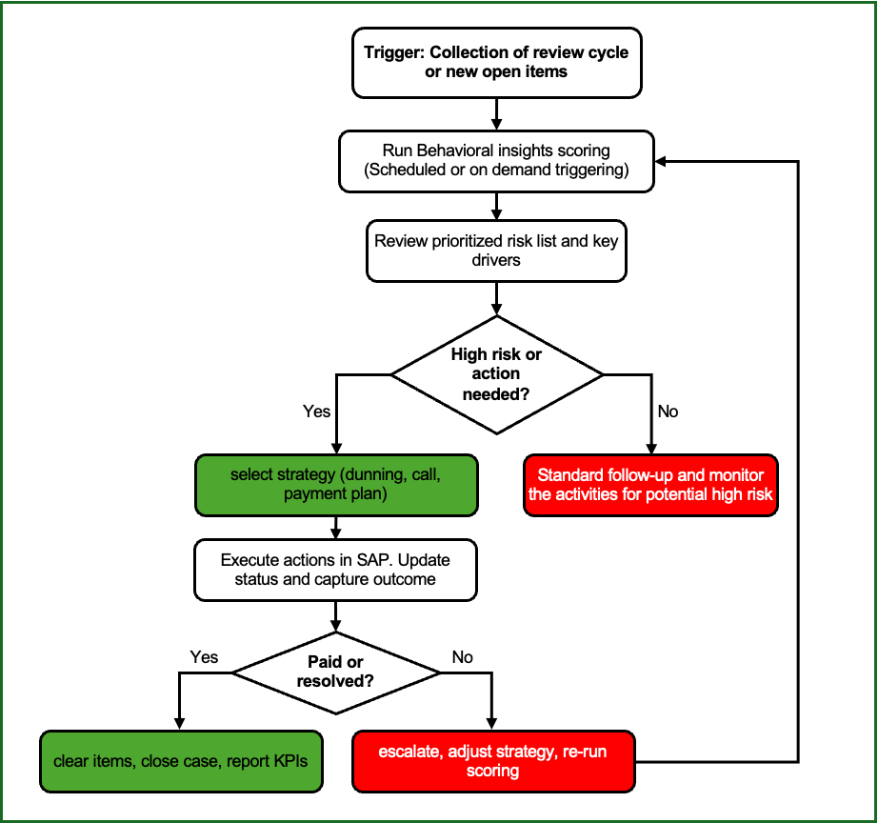
Annexure:
Process Overview:
Behavioral Insights is triggered by a review cycle or new open items, running a scoring process to produce a prioritized risk list with key drivers
The collector reviews the list, acts on high-risk items (choosing and executing a strategy in SAP), and records outcomes. Resolved or paid items are cleared and KPIs are reported
Unresolved cases are escalated or the strategy is adjusted, and scoring is rerun in a loop for subsequent review cycles.
Process Flow of Behavioral Insights Agent

Slide 55
Behavioral Insights Agent: Executive Bad Debt Reserves and Allowances
Purpose: Improve allowance and reserve decision quality by adding behavior-based risk segmentation and explainable drivers to the reserve review cycle.
What the agent does: Predicts payment risk for contract accounts using historical customer behavior and explains the main factors driving that risk.
Key inputs: exposure and aging, payment behavior history, dispute and deduction posture, policy thresholds, decision history.
Outputs (what users get)
Risk score (0-100 style) for contract accounts
Explainability (top drivers of risk)
Risk segments (Low, Medium, High) to support reserve stratification
Where it fits in the process (L5 placement)
Execute Bad Debt Reserves and Allowances
Used during reserve review cycles and when new open items or risk changes require reassessment
Process change (Before vs After):
Before
Allowance and reserve segmentation relies mainly on aging buckets, overdue amount, and manual judgment
High effort to identify true-risk accounts, inconsistent rationale across reviewers
After
Risk scoring becomes a first-class input for reserve segmentation (alongside aging and exposure)
Explainability supports defensible reserve rationale and faster review
More consistent segmentation, reduced manual triage, targeted focus on highest-risk accounts

